Slide 1
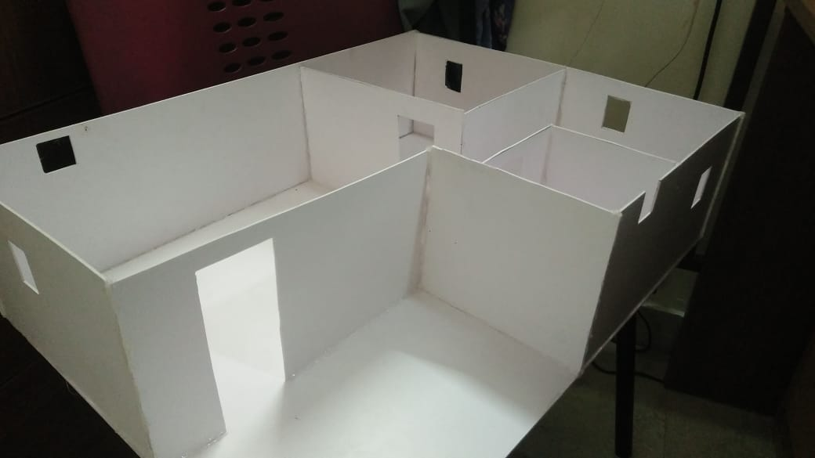
THE COMPLETE HOME
ASHITA-17BEC7039 TATHAGAT-17BCE7100
ROHIT-17BEC7024
MANJARI-17BCE7075
NAGARJUNA-17MIS7162

Slide 2

REQUIREMENT AND COMPONENTS
Presently with the need of smart and internet based things , its only important for engineers today to understand the need of automate smart , automated, safety and mathematical model implementation of a home . A small try to the same cause is what we seek through our try to it .
We have came across a wide linkage of ideas , and have intended to built through a miniature model for the same .
We have been understanding the usage at large scale of Arduino , Raspberry , node mcu and other such microprocessors which will be further demonstrated in the following slides

Slide 3
COMPONENT LIST
ARDUINO UNO
RASPBERRY
FIRE SENSOR
SMOKE SENSOR
NODE MCU
GARDENING SYSTEM
SECURITY LOOK
SERVER AND SOFTWARE SET UPS
HOME AUTOMATION SENSORS
Self analytical watering system
LDR light system
Light ambiguous power nodes
Temperature and weather predictor
Machine learning automations to home
Mobile app + web application

Slide 4
REINFORCEMENT LEARNING MODEL
Raspberry pi is used to implement deep learning and machine learning algorithms
We have installed a machine learning weather predictor using VSM classification model
It takes temperature , humidity through DHT11 and sunrise , sunset time through web or intelligent learning , then convert them to csv , finally forms a server lAN location to sent alert at a specific time in a day.
HARD CODING SENOR LEARNING
VOICE CONTROLLED SERVER GENERATED HOME APPLIANCE CONTROL USING NODE MCU
Automatic self assessing gardening light , temperature and water model using Arduino
Fire and smoke sensor for KITCHEN SAFETY.
Generous door lock car pattern system .
Building a 3D model of areal house .

Slide 5
WORKING OF PI based WEATHER ANALYST
SETTING PI CLUSTER AND SERVER
OBTAINING INFORMATIONAL DATA THROUGH DHT11 AND WEB ANALYSIS
APPLYING VECTOR MACHINE LEARNING MODEL TO PROCESS THE DATA
SENDING TO INFORMATION TO NODEMCU BASED SERVER
MANIPULATING INFORMATION TO SEND TO EMAIL EVERDAY AT 12:45pm

Slide 6
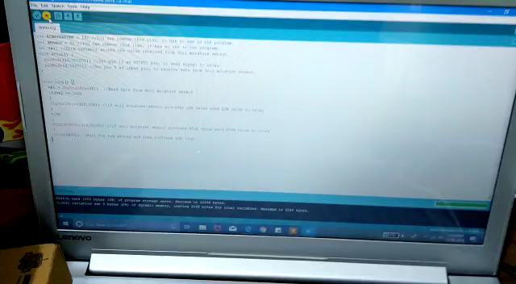
GARDENING SYSTEM
Helps automatic gardening at times of family trip and other outings of the owner.
Correct mathematical analysis helps in maintain ecosystem as well as understanding plants and lifecycles better.

Slide 7
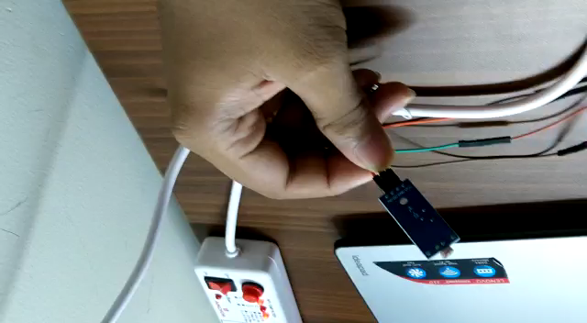
LDR
Helps automatic detection of night time lighting system
During night thefts and problems can be very fruitful
Moreover during trips when we reach at night , it is an efficient tool for automation indices.

Slide 8
VOICE CONTROLLED MODELLING
Using the nlp based google assistant we are able to figure speech to text .
Then using server and connection LANs we send info to modem cu .
NODE MCU helps to connect as many as possible devices to connect to forms a complete home automated setup
Further by using raspberry to micro control the processor we can reach out to important emails for certain devices in the home as well.

Slide 9
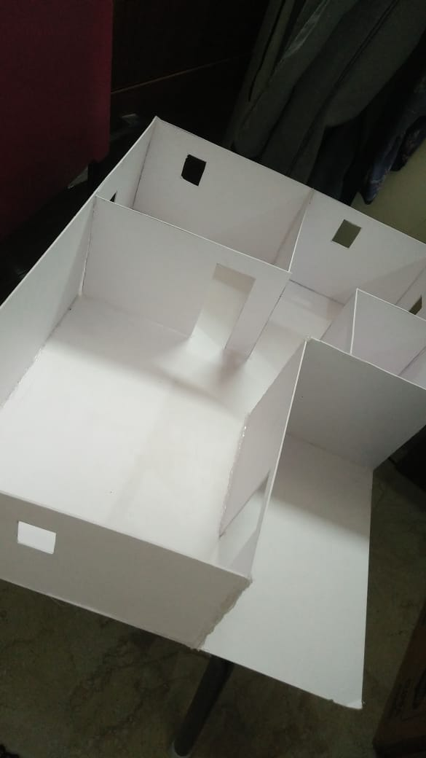
3D MODEL

Slide 10
FUTURE OBJECTIVES AND PLAN
NAMES / DURATION | ASHITA SATPATHY | Tathagat Banerjee | Manjari Bisht | Rohit | M.Nagarjuna
15th September to 30th September | INSTALLATION OF HOME SYSTEM | DEEP LEARNING INVOKED SERVER AND MAIN NLP | FIRE DETECTION AND ALARM | CIRCUITARY DETECTION OF ALL COMPONENTS | SMOKE ALARM DETECTION
1st October to 10th October | INSTALLATION OF MAIN CIRCUITARY | 3D MODEL ENHANCEMENT | WEB MANUAL DEVLOPMENT | INSTALLATION OF MAIN CIRCUITARY | WEB MANUAL DEVLOPMENT
10th October to 18t October | INSTALLATION OF LOCKING SYSTEM | INSTALLATION OF LOCK SYSTEM | DATABASE ENHANCEMENT ALONG WITH WEB APPLICATION | WORKING OF WATER OVERFLOW SYSTEM | INSTALLATION OF LOCK SYSTEM

Slide 11
THANK YOU (Dhanyawadh)

